Slide 1
Sequenced task list
Christopher I. Macintosh, PhD, RN
Notes:
Hello everyone
My name is Chris Macintosh. I help teach the capstone courses.
Today we’re talking about how to create a sequenced task list for your project.
[Next slide]

Slide 2
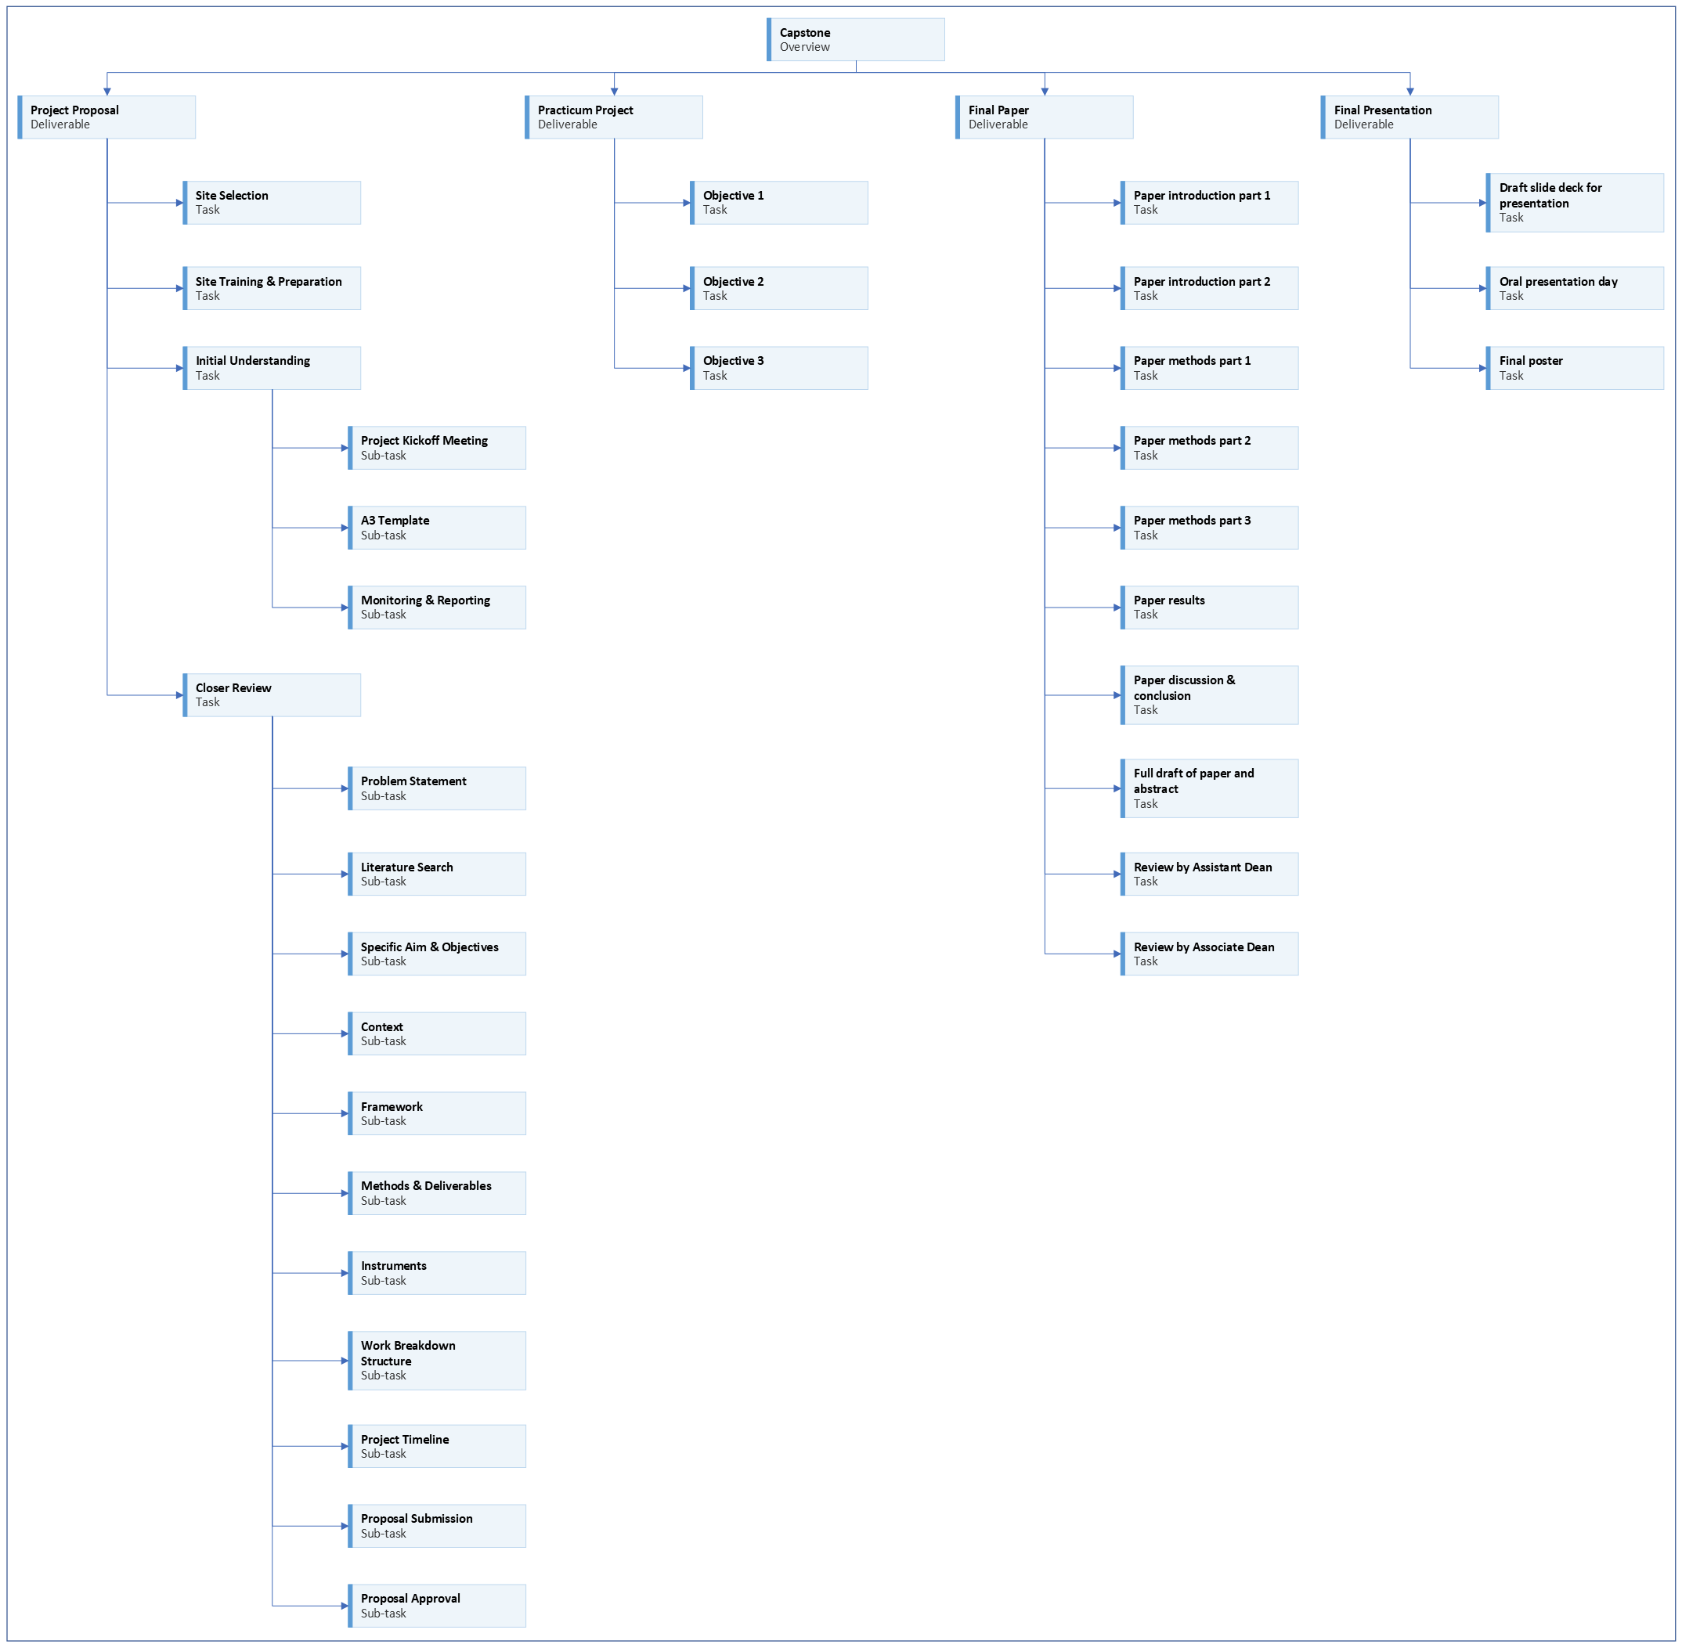
Notes:
We are working on the project proposal portion of your capstone.
[Next slide]

Slide 3
Notes:
Last time we talked about how to create a work breakdown structure list for your project.
[Next slide]

Slide 4
Notes:
Today we will talk about how to create a sequenced task list and project timeline.
[Next slide]

Slide 5

Address feedback
Notes:
You should be addressing any feedback on your assignments and pasting updated content in the appropriate sections.
[next slide]

Slide 6

Wbs list
Project Name
Objective 1 | Objective 2 | Objective 3 | Objective 4
Deliverable 1 | Deliverable 4 | Deliverable 7 | Deliverable 8
Deliverable 2 | Task 4 |  | Deliverable 9
Task 1 | Task 5
Task 2 | Task 6
Task 3 | Deliverable 5
Deliverable 3 | Deliverable 6
Notes:
Once the deliverables have been defined in the WBS, the tasks required to produce each deliverable should be defined.
[next slide]

Slide 7

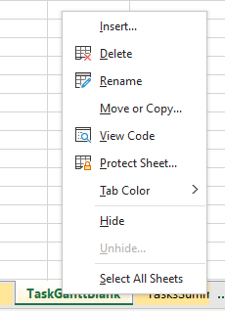
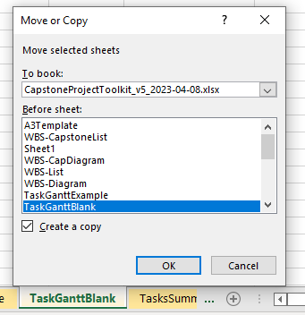
Copy sheet
Notes:
I have included a tool to help you create your task list.
It’s called the TaskGanttBlank sheet in your Capstone Tookit.
[click]
I suggest you create a copy of the sheet and work in the copy.
That way you can delete the copy if you want to start over.
Right-click on the TaskGanttBlank sheet tab.
Select Move or Copy…
[click]
In the Move or Copy popup
Check the box for Create a copy
And select which sheet you want to copy to be next to.
Click OK
[next slide]

Slide 8

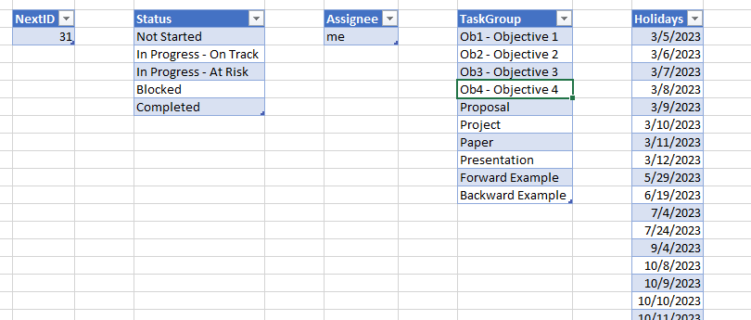
Settings
Notes:
In order to include some functionality I desired, I needed to include some information in a Settings sheet in the Capstone Toolkit.
You’ll see the tab for the sheet close to the TaskGanttBlank tab.
You shouldn’t have to change anything in this sheet, but you can customize it if you want.
For now, you can probably leave things as they are.
[next slide]

Slide 9
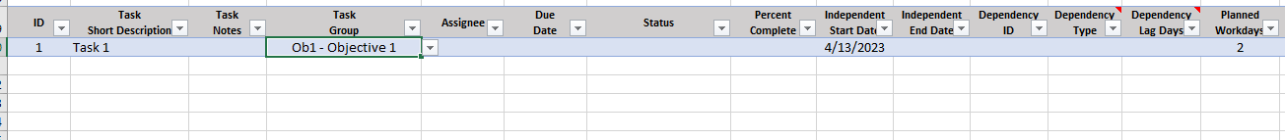

Creating the task list
Notes:
This is what the task list part of the TaskGanttBlank sheet looks like.
Here’s how I suggest you go about creating your task list.
[click]
I would start with your first objective, and go through the deliverables in order.
If the deliverable is straightforward without multiple tasks, you can just list the deliverable name in the Task Short Description field.
If multiple tasks need to be completed, give each task a short name in the Task Short Description field.
[click]
Give each task a unique ID number.
I suggest starting with number 1 and use sequential numbers from there.
The actual ID number doesn’t matter much. It’s just an ID.
If you need to make changes later, ID numbers will get out of order, but it doesn’t matter.
The ID numbers are just a way to keep track of the tasks if they need to be related to each other.
[Click]
Select the Task Group for each task.
I suggest associating tasks with the appropriate objective.
[click]
Each task needs a duration (called Planned Workdays).
How many days do you think it will take you to complete the task?
Enter that number in the Planned Workdays column.
If you’re not sure how long it will take, just make your best guess.
This can always be changed later and all the dates in the sheet will be automatically recalculated.
If you don’t enter a number, the formulas in the sheet will assume it will take 1 day.
[click]
If another task needs to be completed before the current task starts, then the ID for the other task needs to be entered in the Dependency ID column.
When you have dependencies, you don’t need to specify a start date.
The start date will be automatically calculated for you depending on when the previous task is scheduled to be completed.
If you update the schedule, the new dates for the task will automatically be calculated.
[click]
If the task doesn’t depend on another task to be completed first, then you can enter an independent start date.
This can just be an estimated date. The date can always be changed later.
[click]
Go through each objective and each dependency and add tasks in this manner until all the tasks for your project have been added to the list.
[click]
As you enter all this information, the Planned Start and Planned End columns will automatically populate with the projected start date and end date for each task.
[next slide]

Slide 10
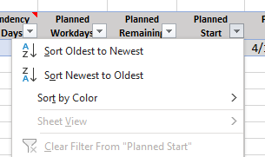
sorting the task list
Notes:
Once the task list is created, you can sort the list so the tasks are arranged in chronological order.
Click on the button in the Planned Start column.
[click]
Select the option to Sort Oldest to Newest.
[next slide]

Slide 11
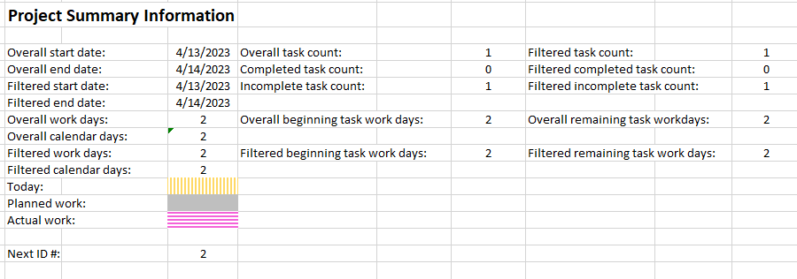
Project summary
Notes:
Project summary information is displayed along the top of the TaskGanttBlank sheet.
[click]
You can see an overall start date
[click]
An overall end date
[click]
And a task count.
Along with other information
[next slide]

Slide 12
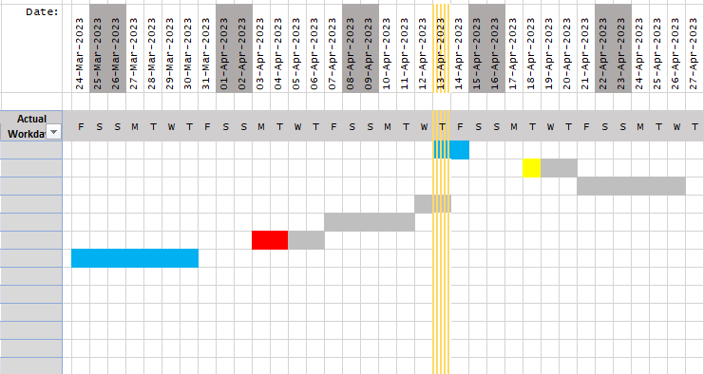
Gantt chart
Notes:
If you scroll to the right of the project list, you will see a graphical representation of tasks organized by dates.
This type of chart is called a Gantt chart.
The name is not important.
It’s just a nice way to see how the tasks of a project line up according to date.
[next slide]

Slide 13

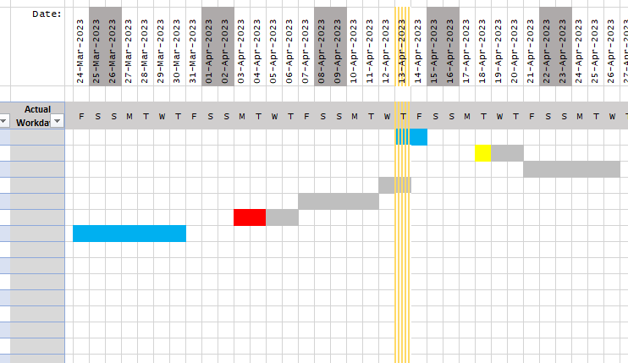
assignment
Notes:
[click]
Your assignment is to create a sequenced task list and timeline for your project in a copy of the TaskGanttBlank sheet of your Capstone Toolkit.
Submit the sheet in Canvas.
[next slide]

Slide 14

More to come . . .
Notes:
That’s all we’ll do in this video.
Once you complete your sequenced task list and project timeline, you have completed all the steps to create your project proposal.
Address any feedback from previous assignments.
You will find an assignment in Canvas where you can submit your complete project proposal.
There is more to come next semester when we start working on your capstone manuscript.
[next slide]

Slide 15
References
Schwalbe, K. (2021). Healthcare project management, third edition: Predictive, agile, and hybrid approaches. Schwalbe Publishing.

